Slide 1
THE QUIZZY

Slide 2
Presented By Nazmus Shakib Riad
Roll: 1607096
Group : B2
2nd Year 1st Semester
CSE,KUET

Slide 3
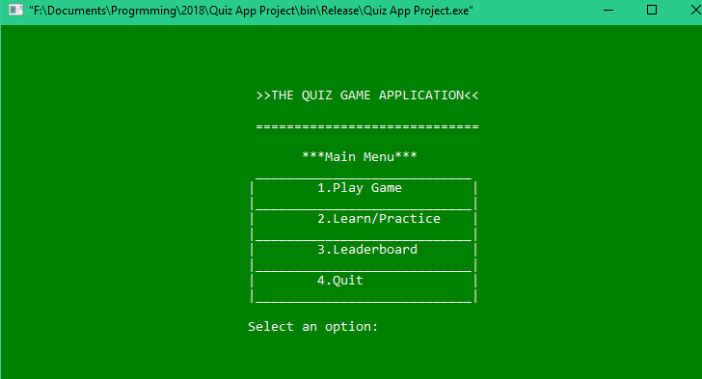
Project Principles
Welcome to my mini project based on a quiz application . It is used C++ as an object oriented
programming language to make this project . There are mainly three core features in this project-
Game Difficulty
Easy
Medium
Hard
2. Learn/Practice Mode
3.Leaderboard

Slide 4
Project Principles
1. Game Difficulty : Initially there are normally two topics - English and Mathematics.
Each of these contains three level of difficulty .
2. Learn/Practice Mode : In this mode one can learn/practice before taking part into the main quiz. Moreover one can find solution of related problem . Such as it can be used for
dictionary for vocabulary or calculator for solving matrices or complex number operations etc.
3. Leaderboard : After finishing the game players are required to submit their name .
Results statistics is saved to form a ranking table so that everyone can evaluate their position and progress . Leaderboard can help to be more competitive .

Slide 5
Objectives
The probable objectives of this project are :
To help students for acquiring knowledge in fundamental subjects.
To prepare thyself for competitive exam siiting in home or anywhere
To help job applicants and save their time wasting in many coaching centre.
To prepare one more competitive .
To save cost spending for different guides or note books for job preperation.

Slide 6
Project Discription
# Namespace : Initially there are normally two topics - English and Mathematics.
Each of these contains three level of difficulty .
# Getter Setter : In Ques_bank class, to set question and option it has used setter and getter function .
# Formatting Input Output: To calculate and show float type score it has used setprecision under <iomanip> header file .

Slide 7
Project Discription
# File : To save all players record it has used a file to store them and reading file it has made leaderboard from file .
# Class and Object : There are several class and object for Ques_bank , Score and each subject .
# Constructor & Destructor: In score class it has used parameterised constructor,destructor
and also used Dynamic Memory Alloaction here .

Slide 8
Project Discription
# Dynamic memory allocation : In Learn/practice sector there used dynamic memory allocation in matrix .
# Operator Overloading : In Math practice section there used several type of operator overloading .
# getline() after cin: After finishing the game players are required to submit
Results statistics is saved to form a ranking table so that everyone can evaluate their position and progress . Leaderboard can help to be more competitive .

Slide 9
Project Discription
# Template : Initially there are normally two topics - English and Mathematics.
Each of these contains three level of difficulty .
# STL : It has used priority queue to bulid up leaderboard sorted .
# Functor & Lambda Function : After finishing the game players are required to submit
Results statistics is saved to form a ranking table so that everyone can evaluate their position and progress . Leaderboard can help to be more competitive .

Slide 10
Project Discription
# Inheritance : It has used Ques_bank base class and related topics derived class to inherit properties .
# Polymorphism : In math section there used function overloading which is the example of complie time polymorphism .

Slide 11

THANK YOU

